Slide 1
Stock Predictions Project Presentation
By: Dinesh Daultani

Slide 2
Biography
Completed bachelor’s in Computer Science from Chameli Devi School of Engineering, Indore, India in 2014
Currently working as a Statistical Analyst Intern in RR Donnelley
Proficient with lots of programming languages such as C, C++, Java, Python, R
Have proficient technical knowledge of various computer science domains
Involved in lots of committees on campus and off-campus
Indian Student Association (President)
Intel Student Ambassador AI
Graduate Student Advisory Council
Internationalization Student Panel (member)

Slide 3
Why I chose this project
Always geared towards learning new technologies or work on some challenging tasks
Interest to learn machine learning
Interesting topic
Project was challenging and involved lots of opportunities to learn new technologies/skills

Slide 4
Overview
Introduction
Machine Learning Intro
Data Gathering
Data Processing
Sentiment Analysis
Training Models
Challenges & their solutions
Most Difficult parts
Lessons Learned
Future Improvements
Conclusion

Slide 5
Introduction
Problem Statement: To predict stock prices based on news articles
EMH (Efficient Market Hypothesis) – Stocks can’t be predicted based on historical prices.
Stocks
DJIA (Dow Jones Industrial Market Average) stock indices
News articles
Show current market conditions about all the companies
Machine Learning
Various algorithms

Slide 6
Machine Learning Intro
“Machine learning is concerned with computer programs that automatically improve their performance through experience.”​
-- Herrbart Alexander Simon.​

Slide 7
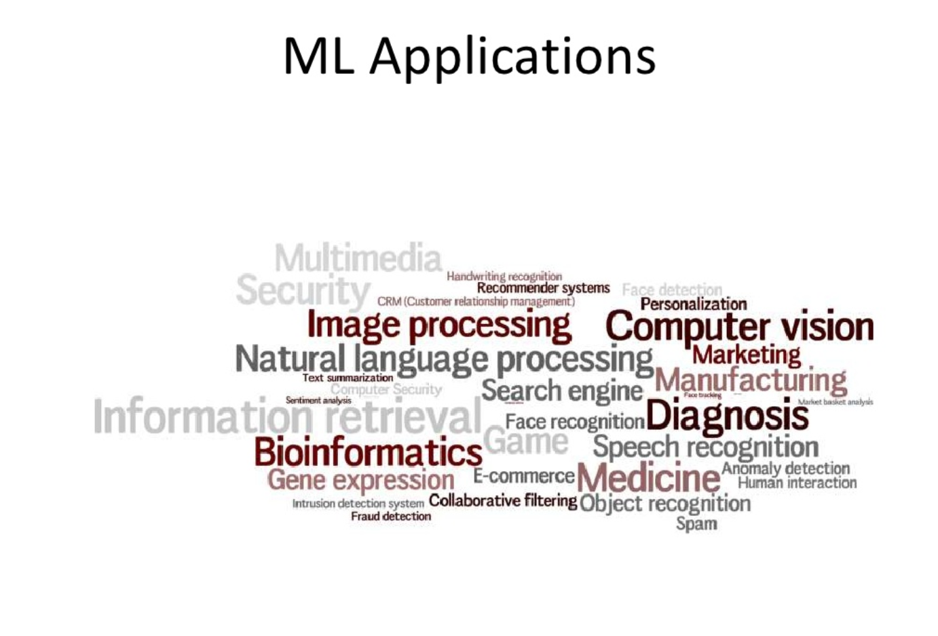

Slide 8
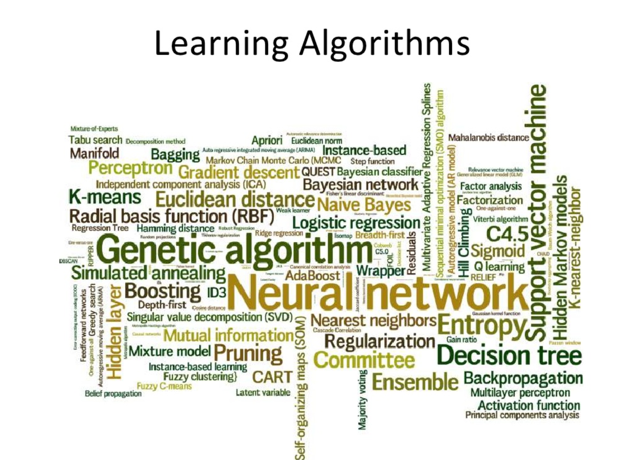

Slide 9
Types of Machine Learning problems
Classification
Regression
Clustering
Rule Extraction

Slide 10
Data Gathering
Stock Indices:
DJIA index prices
Snippet:
NY Times Archive API
News articles
Both data are collected for 10 years i.e. 2007 - 2016

Slide 11
Data Processing
Articles Filtering:
Sections included: 'Business', 'National', 'World', 'U.S.' , 'Politics', 'Opinion', 'Tech', 'Science', 'Health' and 'Foreign‘
Approximately 400,000 articles selected from 1 Million articles
Merge stock indices closing price with articles
Storing (pickling) the data

Slide 12
Sentiment Analysis
NLTK (Natural language toolkit) package
It is a suite of open source Python modules, data sets and tutorials supporting research and development in Natural Language Processing
Vader Sentiment Analyzer
A simple rule-based model for general sentiment analysis

Slide 13
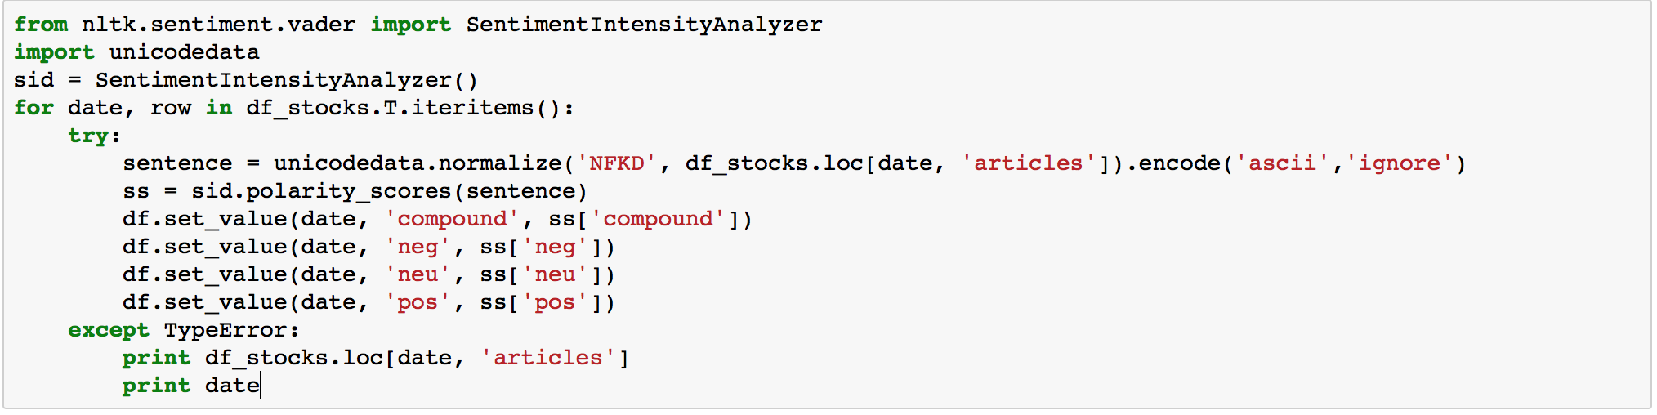
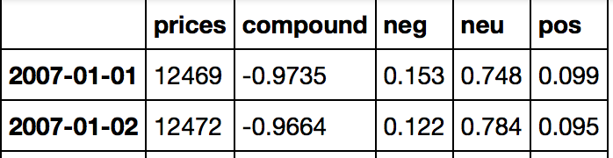
Sentiment Analysis (Continued)
Code Snippet:
Output from sentiment analysis:

Slide 14
Training models
Different models based on splitting of the data:
Training data - 8 years, Testing data - 2 years
Training data – 10 months, Testing data – 2 months (Repeat the process for 10 years of data)
Models applied:
Random Forest
Linear Regression
Multi-Layer Perceptron

Slide 15
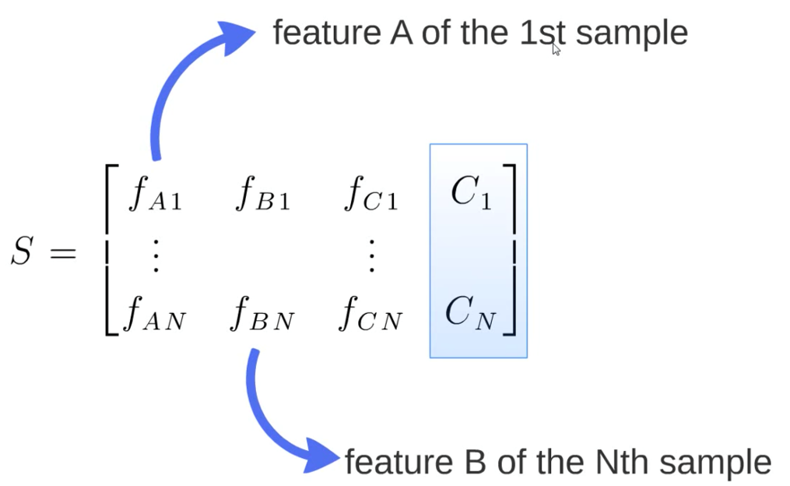
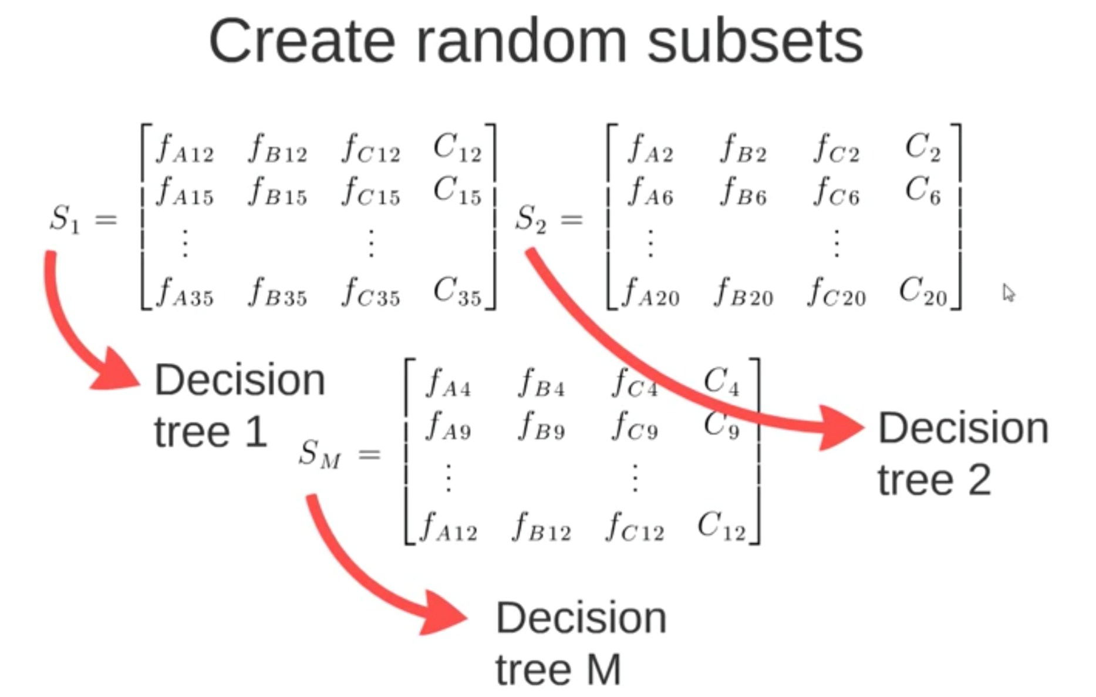
Random Forest Algorithm

Slide 16
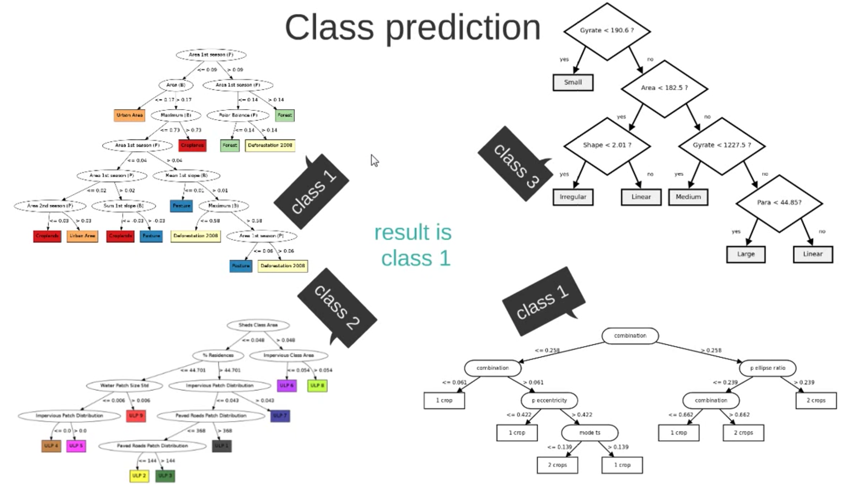

Slide 17
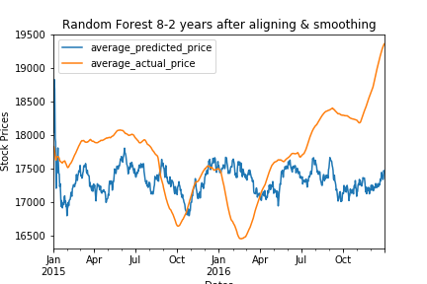
1. Random Forest
Method 1:
Training – 8 years
Testing – 2 years
Code snippet:
rf = RandomForestRegressor()
rf.fit(numpy_df_train, y_train)

Slide 18
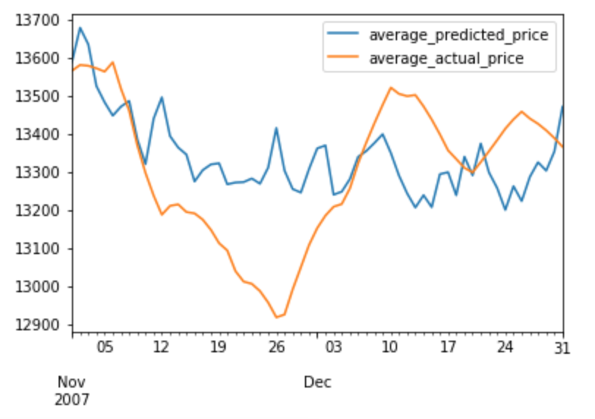
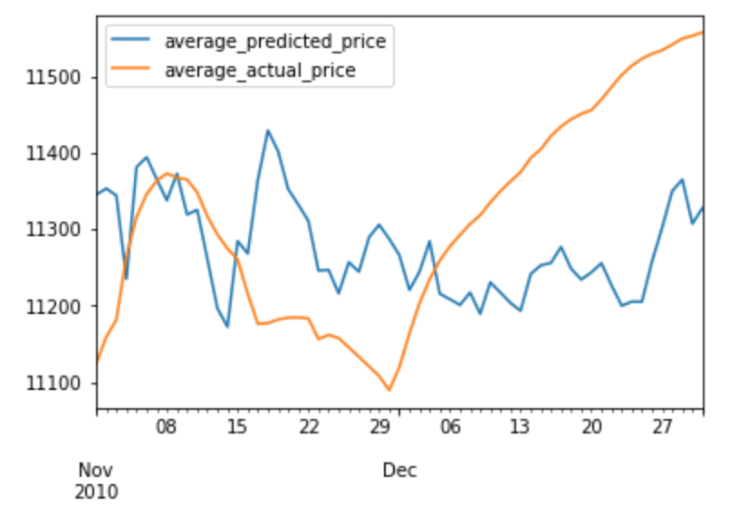
Random Forest (Continued)
Method 2:
Training – 10 months
Testing – 2 months

Slide 19
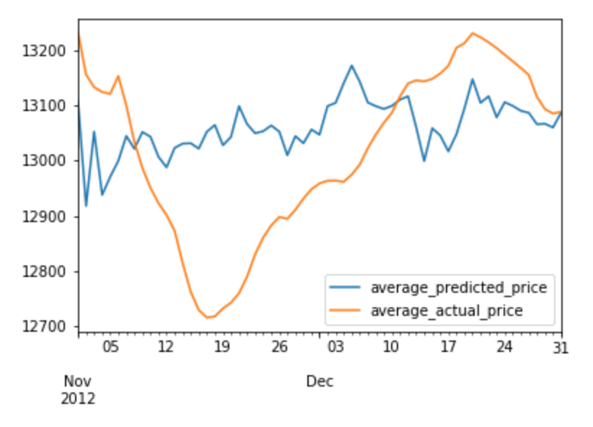
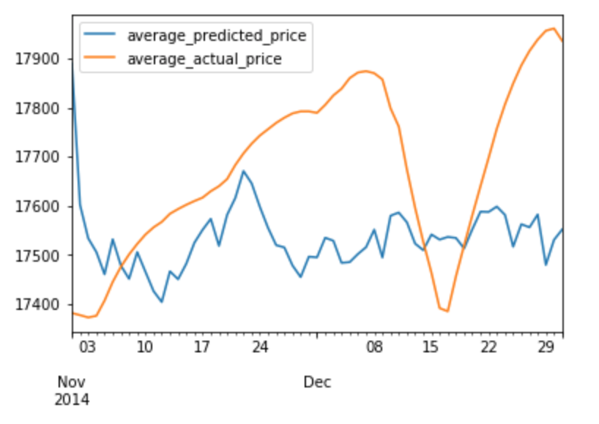
Random Forest (Continued)

Slide 20
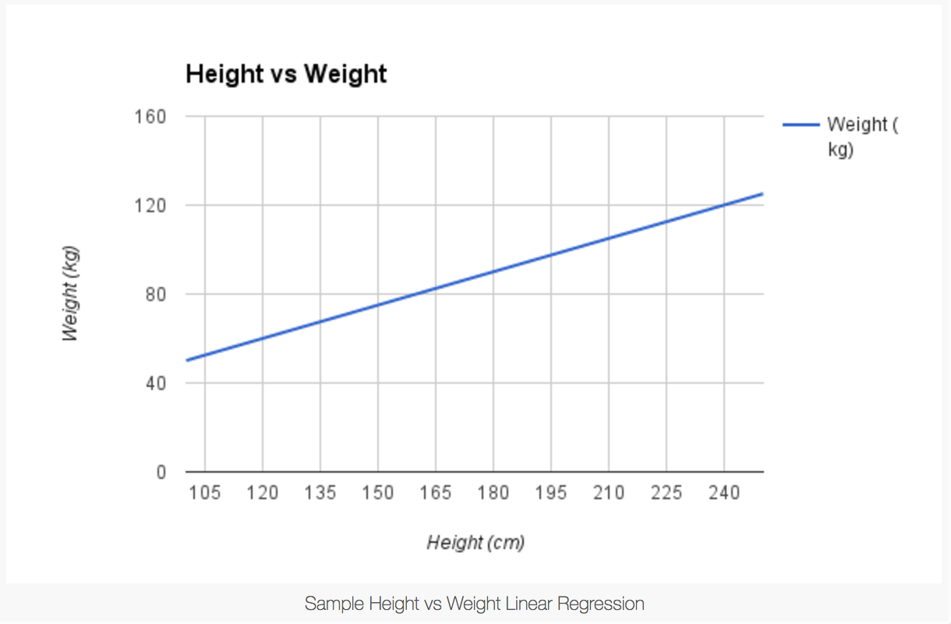
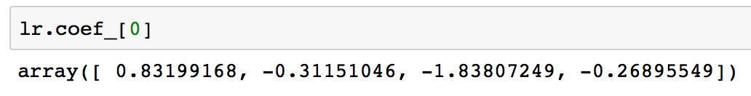
Linear Regression Algorithm
Coefficients for 4 features from Linear Regression Model

Slide 21
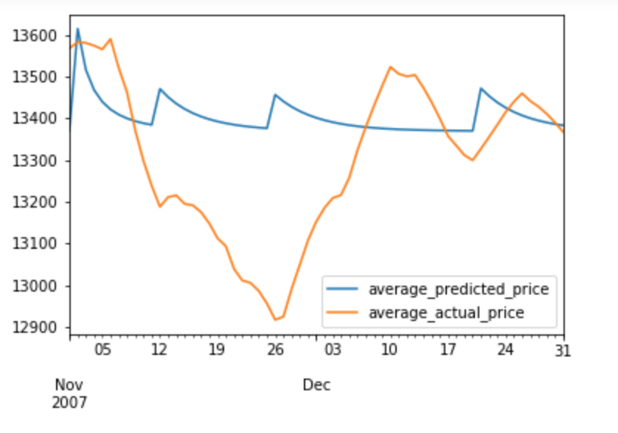
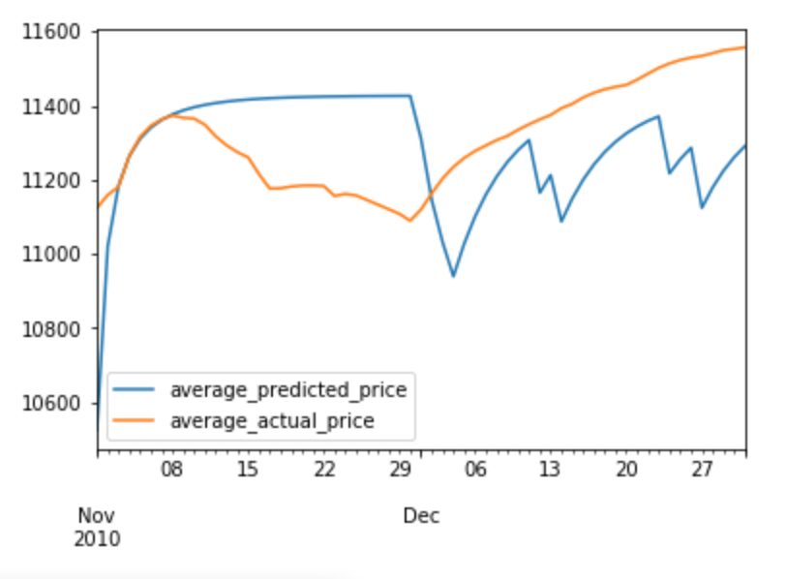
2. Linear Regression(Continued)
Method 2:
Training – 10 months
Testing – 2 months
Code Snippet:
lr = LogisticRegression()
lr.fit(numpy_df_train, train['prices'])

Slide 22
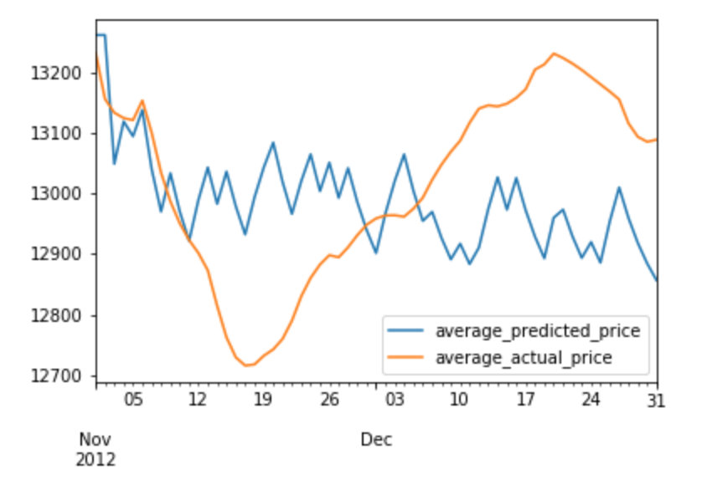
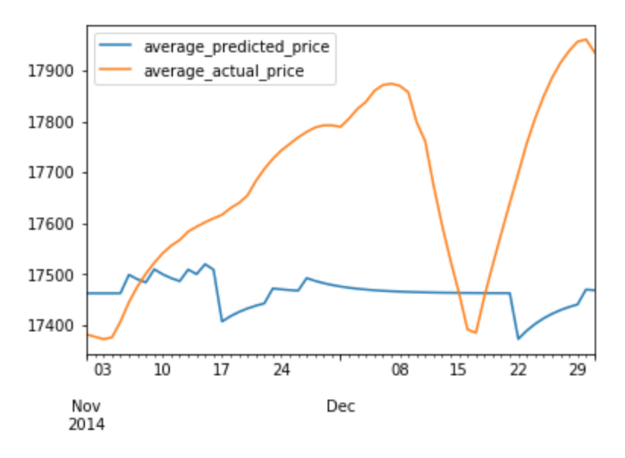
Linear Regression(Continued)
Method 2:
Training – 10 months
Testing – 2 months

Slide 23
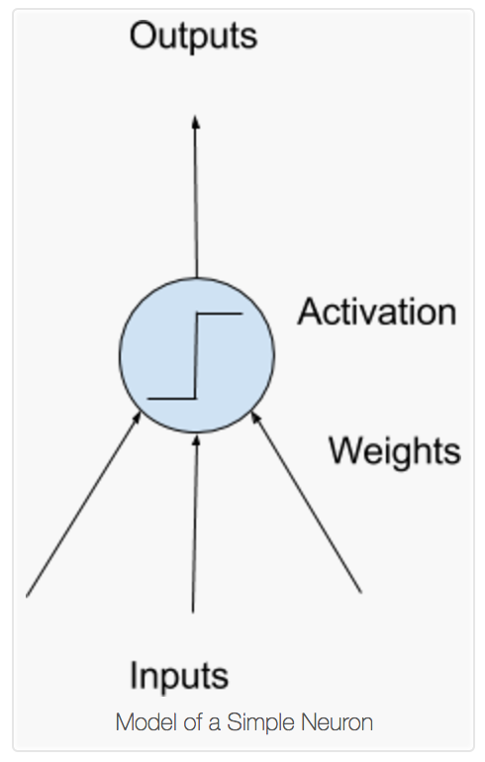
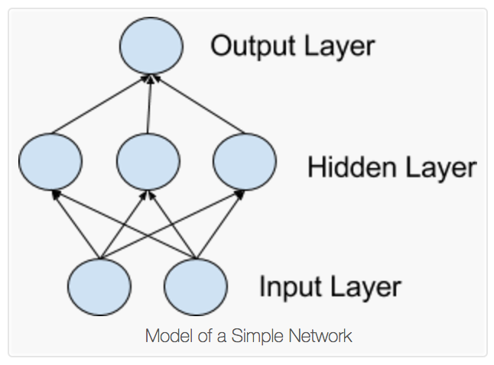
Multi Layer Perceptron (Neural Networks)

Slide 24
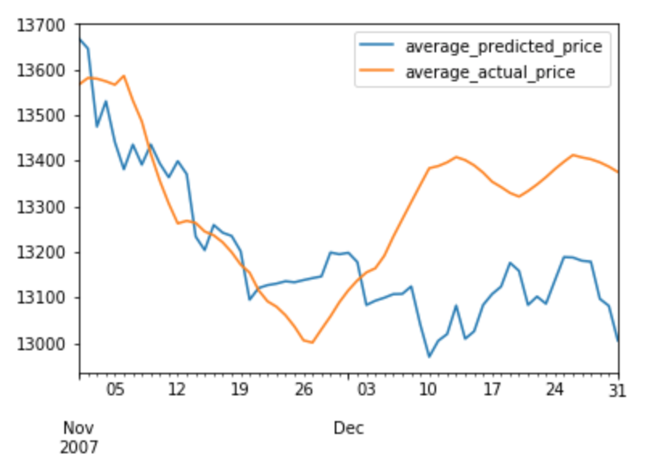
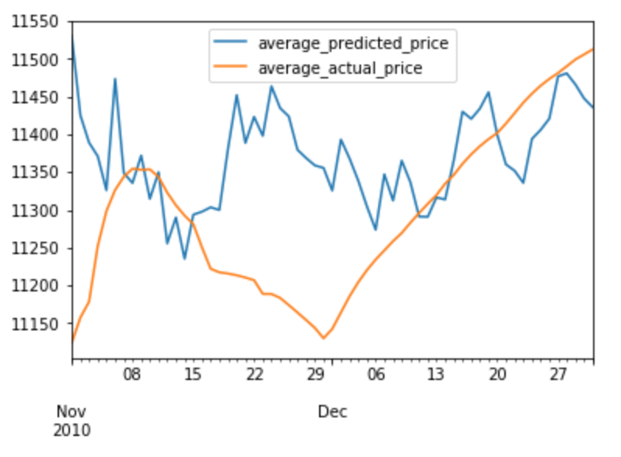
3. MLP Classifier
Code Snippet:
mlpc = MLPClassifier(hidden_layer_sizes=(100, 200, 100), activation='relu', solver='lbfgs', alpha=0.005, learning_rate_init = 0.001, shuffle=False)
mlpc.fit(numpy_df_train, train['prices'])
Method 2:
Training – 10 months
Testing – 2 months

Slide 25
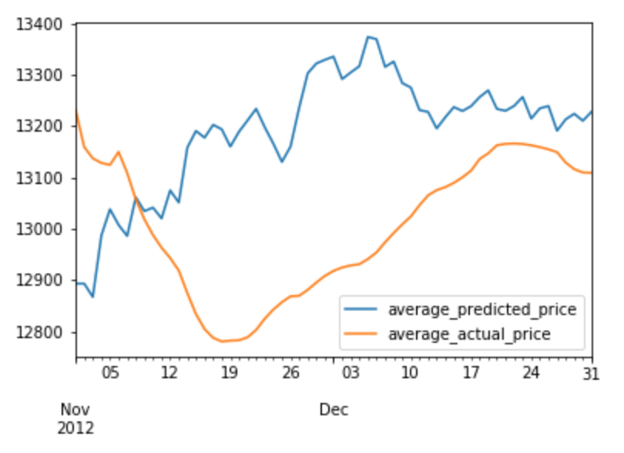
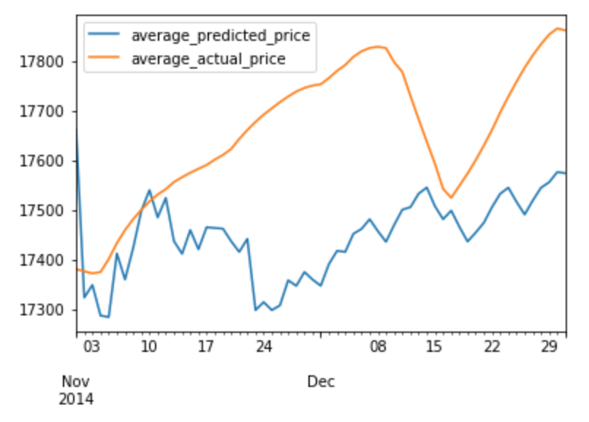
MLP Classifier (Continued)

Slide 26
Challenges and their solutions
Missing stock indices - Interpolation
Filtering of the news articles – Skipping those articles
High fluctuations in prices – Smoothing (Exponentially-weighted moving average - EWMA)
Price change during testing and training – Add the difference between actual and predicted values into predicted values.

Slide 27
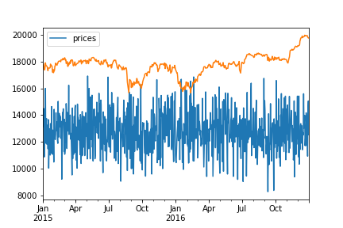
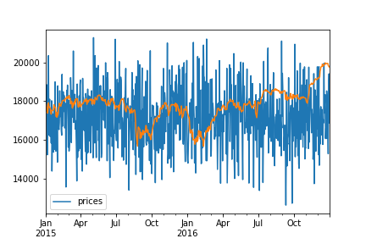
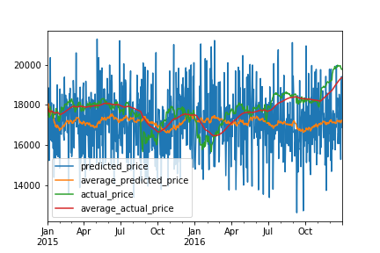
Initial Graph After aligning After Smoothing

Slide 28
Conclusion
MLP classifier gives better results
No model works really well
May be actual article data rather than just headlines data could give more better results

Slide 29
Most Difficult parts
Optimizing the results and applying different algorithms
Data Gathering
Data preprocessing
Gather knowledge about the financial domain
Note: Sorted in the order of level of difficulty

Slide 30
Lessons learned
Any new technology/field could be learned given sufficient time and efforts
Make sure to collect comprehensive data without moving further ahead
Understanding roughly how the research process works
How to deal with financial data and sentiment analysis
How to apply machine learning models

Slide 31
Further improvements
Use CNN and recurrent neural networks
More optimized sentiment analysis specifically for news articles
Include historical analysis of stock indices itself
Predict individual companies stocks based on optimized trained model

Slide 32
Thank You
Any Questions!

